Slide 1
Zara Fashion Trends Prediction Model
Elsa Figueroa
Gauri Gupta
Miga Budaasuren
Termeh Mohebbie

Slide 2
Table of Content
01
Introduction
04
Model Training
02
EDA
Limitations
05
03
Data Transformation/Feature Engineering
06
Conclusion

Slide 3

Introduction and Goal
The main goal of this analysis is to predict the best-performing products for the last week in terms of revenue using the previous week’s data.
This dataset is from a real-world Machine Learning Contest from a major retailer, ZARA, in 2019 with a cash prize.
The data includes 3 months worth of sales, stock, and positioning of items for ZARA online store in a specific country.

Slide 4
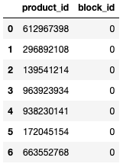
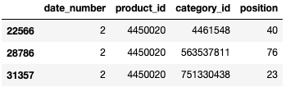
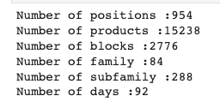
Exploratory Data Analysis
Notes:
any given product have multiple positions
multiple products belong to a certain block
Some stats for the datasets

Slide 5
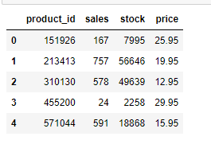
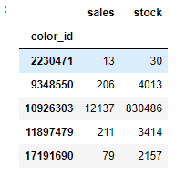
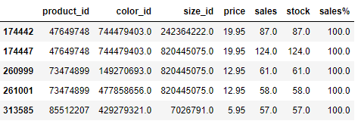
Exploratory Data Analysis

Slide 6
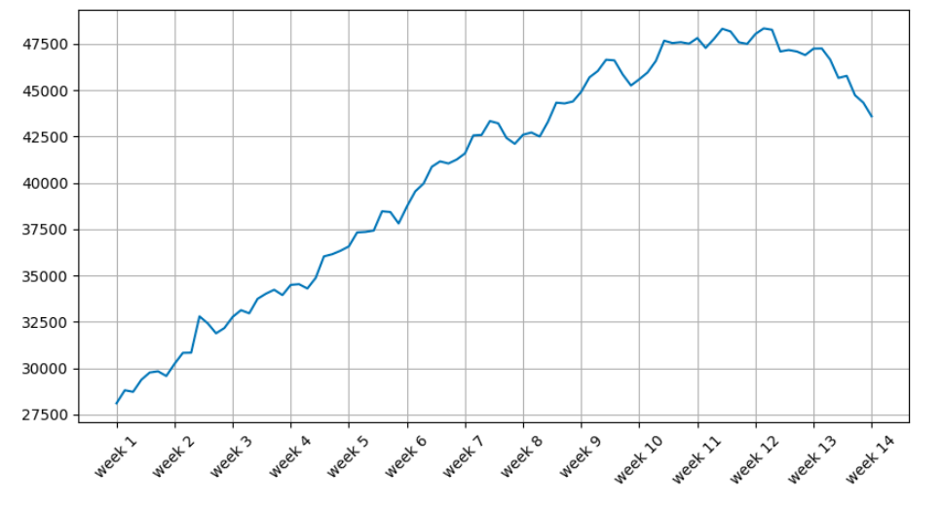
Exploratory Data Analysis
Sales Trend
Notes:
there has been a consistent increase in sales over time, indicating a positive trend. However, the most recent three weeks have shown a sudden decrease in sales. This sudden decrease is a cause for concern and would require further investigation to identify the underlying causes.
To better understand the trend in sales, the team could perform a time-series analysis to visualize sales data over time and identify any seasonality or trends. They could also segment the data by product, location, or other relevant factors to identify any patterns or relationships between variables.
The sudden decrease in sales in the last three weeks may be due to a variety of factors, such as changes in consumer behavior, increased competition, or supply chain disruptions. It would be essential to gather additional data and conduct further analysis to understand the root cause of the decline in sales.

Slide 7
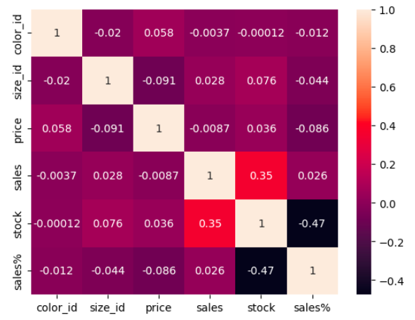
Exploratory Data Analysis
Correlation Map
Strong correlation between sales and stock
No other significant correlation
Notes:
the level of stock is closely related to the level of sales, indicating that when stock is high, sales tend to be high as well. However, the analysis did not find any significant correlation between sales and other variables, which may suggest that stock is the most critical factor influencing sales. It is worth noting that while there may be no significant correlation with other variables in the current dataset, there could be additional variables outside of this dataset that may have an impact on sales. Therefore, it is important to continue exploring and analyzing data to identify all the relevant factors that affect sales.

Slide 8
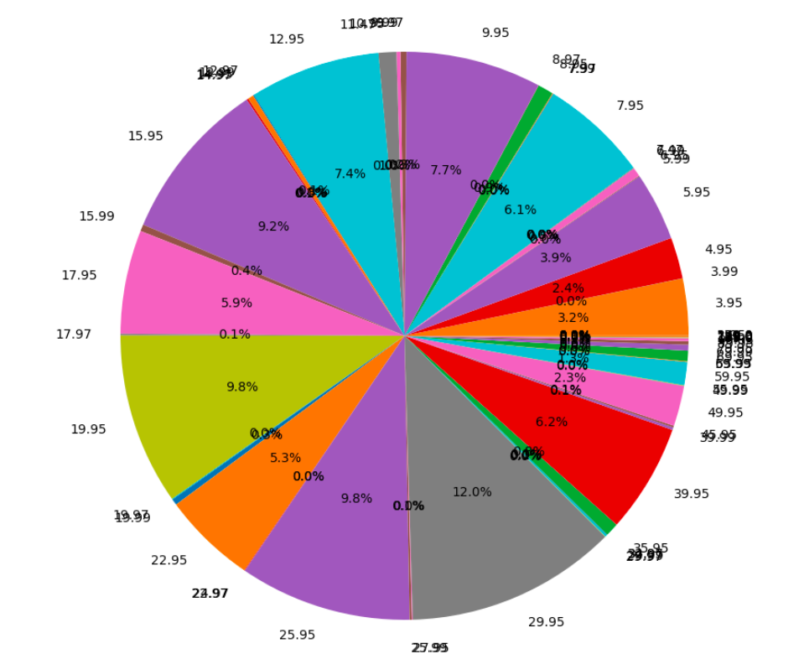
Exploratory Data Analysis
11.99
10.99
Stock Level by Price
13.99
8.97
5.99
We can see the price points for products that have the largest stock are $29.95 and $25.95
19.99
35.95
27.95
Notes:
The statement suggests that there are specific price points for products that have the largest stock, with prices of $29.95 and $25.95 being the most common. This information can be used to develop pricing strategies that take advantage of the popularity of these price points and to optimize inventory management to ensure that there is sufficient stock of products at these price points to meet customer demand.

Slide 9
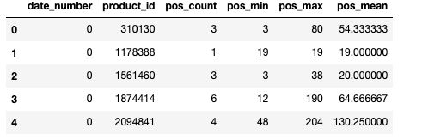
Data Transformation & Feature Engineering
Notes:
EDA shows that any given product have multiple positions. So we decided to aggregate the position . Added the several aggregation results into the original data as additional features.

Slide 10
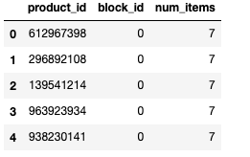
Engineering Engineering
Data Transformation & Feature Engineering continues
Notes:
Similarly, for the block column, EDA shows multiple products belong to a certain block. So again, we decided to aggregate the data and added new columns as num_items (new feature).

Slide 11
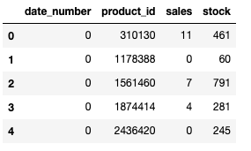
Data Transformation & Feature Engineering continues
As we are interested in product level, we removed the color_id and size_id columns. Then aggregated the sales and stock columns by product only.

Slide 12
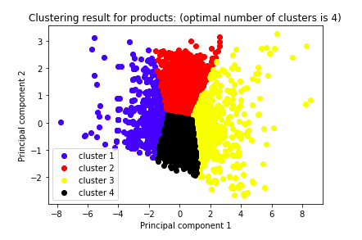
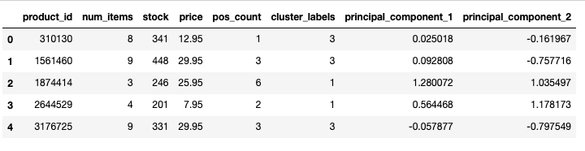
Data Transformation & Feature Engineering continues
Notes:
As the last feature engineering, we chose the last day in the training data ( day 84). Then used unsupervised ML ( to be specific k-means (to find the optimal number of clusters) and PCA (to reduce the dimension and as a result it will give us more clean clusters)) . Plotted the results and added the cluster labels column to the original data as another new feature.

Slide 13
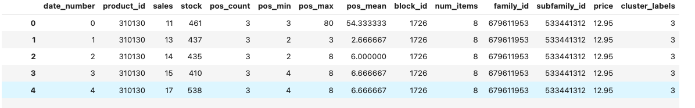
Data Transformation & Feature Engineering continues
Notes:
Merged all 4 transformed data frames into one data frame. Now, the data is ready for model training.

Slide 14
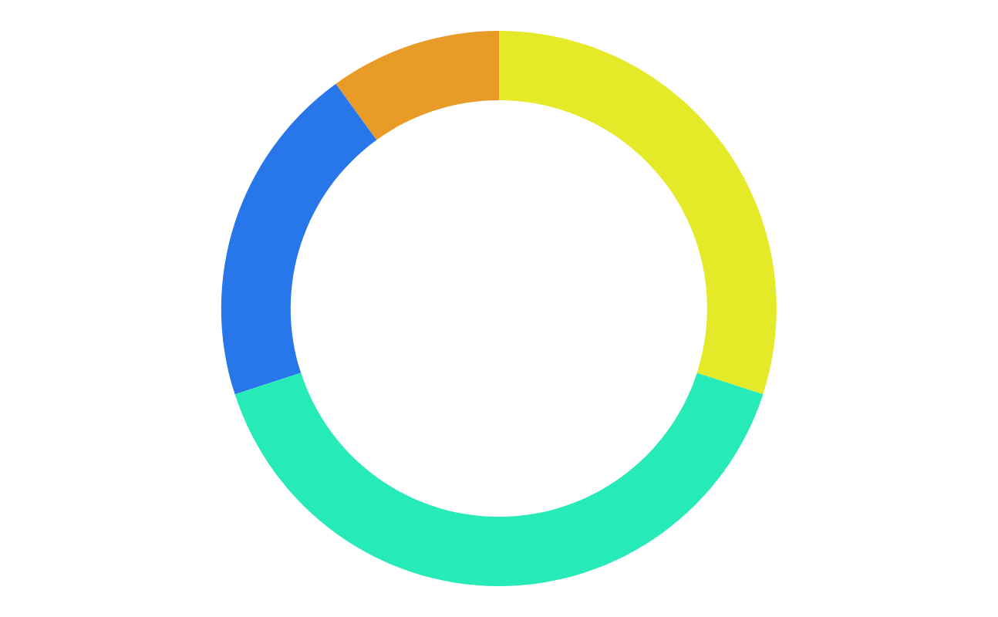
Machine Learning Models
Random forest
Deep Learning
XG Boost
Notes:
-We used 3 different ML models which are RF, XG Boost and DL.
-Classification models such as Logistic Regression would not work in this case since our target variable is numerical.
-Also did not experiment with linear regression because this will go very wrong as we were not able to normalize the categorical variables using dummy variables (0 ,1). The reason is that we have over 15000 products to convert. Even we convert them, still linear regression will suffer from dimensional issue.
-For our project, tree based models work better as they do not depend on data normalization. These models consider each regressor independently unlike linear regression which regressors will have interdependency with each other where data normalization is necessary.

Slide 15
Experiment Results
 | R score
Random Forest n_estimators=100, random_state=42 | 0.40
XGBoost experiment 1: n_estimators=100, max_depth=7 | 0.50
XGBoost experiment 2: n_estimators=200, max_depth=10 | 0.59
XGBoost experiment 3: n_estimators=300, max_depth=10 | 0.60
XGBoost with fewer features experiment 4: n_estimators=300, max_depth=10 | 0.61
Deep learning -2 hidden layers and a total of 50 nodes, 1 output layer -Activation='relu’ , loss='mse', optimizer='rmsprop’, epoch =10 | -3.340532347850811e-06

Slide 16
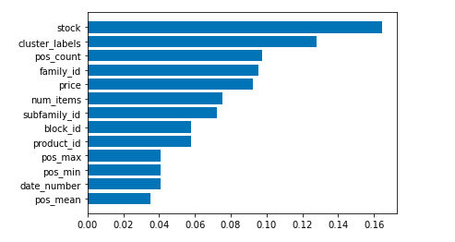
The Feature Importance of the XG Boost 3rd Experiment

Slide 17
Accuracy for top 100 products (by revenue) predicted vs actual
Day | Accurately Predicted Percentage
85 | 66%
86 | 61%
87 | 50%
88 | 49%
89 | 45%
90 | 45%
91 | 51%

Slide 18
Limitations
01 | R score is 0.61 and there is a room to improve
02 | Did not include color and size features which might have an impact on the model performance
03 | Data confidentiality limitation ( did not provide useful insights to use in a real business world)
04 | Only 3 months data

Slide 19
Conclusion
01 | EDA : EDA showed us the complexity of the data. More specifically, the sudden change in the trend and scale of features, etc. This makes the model prediction more difficult.
02 | Feature Engineering : Added new features like cluster labels (2nd), position count (3rd), number of items (5th) were shown as very important features. (Total 13 features)
03 | Model Training : XGBoost provided the best performing model and Deep Learning model was the worst performing model. Random Forest was the medium performing one. Logistic Regression and linear regression will not work for our case.
04 | Prediction : About Top 100 best performing products, we predicted 50-60% accurately. The further forecasting horizon, the lower the accuracy.

